Slide 1
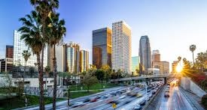


https://linktr.ee/ladataplatform
Notes:
6:50PM
Welcome to Los Angeles Data Platform User Group.
Our User Group meeting will start in 10 minutes.
6:55PM
Our User Group meeting will start in 5 minutes.

Slide 2




Don’t Miss a Meeting
Every third
Wednesday of every month at 7:00PM PST
http://ladataplatform.eventbrite.com/
https://www.meetup.com/los-angeles-data-platform/
mailto:ladataplatform@datadriventechnologies.org
*Click the link to visit the site
https://linktr.ee/ladataplatform
Notes:
Good time of the day everyone, wherever you are. BTW, please drop your city and country into the chat, so we know which communities we are serving.
Welcome to Los Angeles Data Platform User Group! Thank you for joining us today.
My name is Steve and I will the moderator of this virtual meeting. I will be joined by Elaena Bakman, my main partner of crime for community events.
Please visit our Eventbrite and Meetup pages to get notified on any upcoming events.

Slide 3










Follow Us
https://linktr.ee/ladataplatform
https://www.facebook.com/ladataplatform
https://www.twitter.com/ladataplatform
https://www.linkedin.com/company/ladataplatform
https://www.instagram.com/ladataplatform
https://www.pinterest.com/ladataplatform
https://www.youtube.com/ladataplatform
https://rumble.com/c/c-1227574
https://linktr.ee/ladataplatform
https://github.com/Data-Driven-Technologies/
Notes:
If you attending us for the first time and/or would like to follow us, here is our foot-print on a social media.

Slide 4

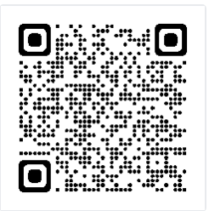
Join our Mailing List
https://linktr.ee/ladataplatform
https://landing.mailerlite.com/webforms/landing/l0u9k0
Notes:
Please feel free to join our mailing list to receive weekly newsletters as well as event notifications.

Slide 5
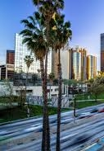



Sponsored by…
Data Driven Technologies Inc., 501.c.3 non-profit
https://www.datadriventechnologies.org
https://linktr.ee/ladataplatform
Notes:
This event is sponsored by Microsoft, Tintri, and Data Driven Technologies, Inc. 501.c.3 non-profit. DDT is the organization behind Los Angeles Data Platform User Group monthly meetings as well as our mega once-a-year event called SQL Saturday in Los Angeles or as well call it now Data.SQL.Saturday.LA.

Slide 6
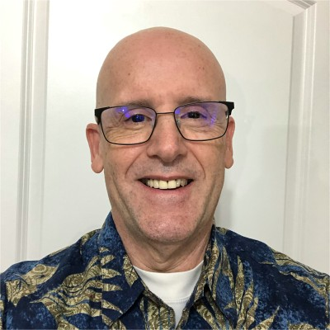
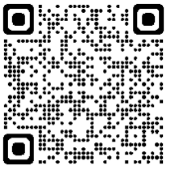
June 21, 2023
LA Data Platform Proudly Presents…
Aurora PostgreSQL with Babelfish
by Bill Ramos
Bill Ramos
Product Manager Technical
https://linktr.ee/ladataplatform
Notes:
During the presentation, please feel free to drop questions in chat or alternatively unmuted yourself to ask questions.
And without further ado, let’s move to the rock star of today’s online meeting. <speaker name>, please take it away and introduce yourself.

Slide 7

End of session
Notes:
Thank you for your awesome presentation. It’s time for more questions and while we wait … don’t forget to stay for the raffle and win our awesome custom t-shirt.

Slide 8
Follow Us
https://linktr.ee/ladataplatform
https://www.facebook.com/ladataplatform
https://www.twitter.com/ladataplatform
https://www.linkedin.com/company/ladataplatform
https://www.instagram.com/ladataplatform
https://www.pinterest.com/ladataplatform
https://www.youtube.com/ladataplatform
https://rumble.com/c/c-1227574
https://linktr.ee/ladataplatform
https://github.com/Data-Driven-Technologies/
Notes:
This session is recorded and will be published to YouTube and Rumble once it’s all polished.
Thank you everyone for joining our online meeting today. With that, thank you, have a great day, and see/hear you next meeting.

